Slide 1
Neo4j data modelling
Anju munoth

Slide 2
Graph data modeling is the process in which a user describes an arbitrary domain as a connected graph of nodes and relationships with properties and labels.
A Neo4j graph data model is designed to answer questions in the form of Cypher queries and solve business and technical problems by organizing a data structure for the graph database.

Slide 3
Overview of the Data Modeling Process
Data modeling is an abstraction process.
Start with your business and user needs (i.e., what you want your application to do).
In the modeling process you map those needs into a structure for storing and organizing your data.
With traditional database management systems, modeling is far from simple.
After whiteboarding your initial ideas, a relational database requires you to create a logical model and then force that structure into a tabular, physical model.
By the time you have a working database, it looks nothing like your original whiteboard sketch (making it difficult to tell whether it’s meeting user needs).
On the other hand, modeling your data for graph technology couldn’t be simpler.
Imagine what your whiteboard structure looks like. Probably a collection of circles and boxes connected by arrows and lines, right?
That model you drew is already a graph. Creating a graph database from there is just a matter of running a few lines of code.

Slide 4
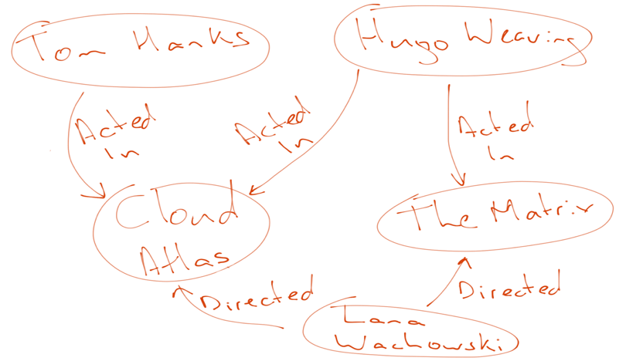
Graph Data Model = Whiteboard-Friendly

Slide 5
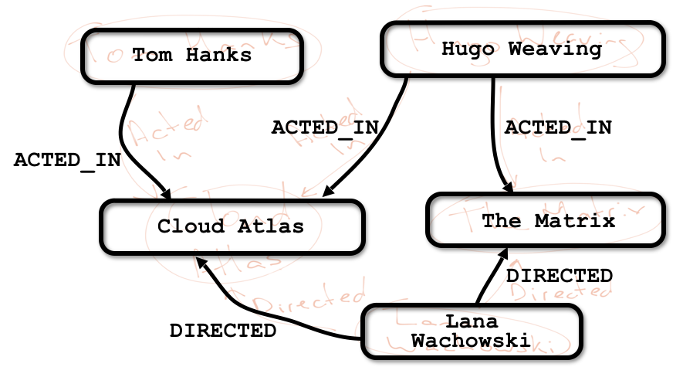
Matrix - match node and relationship format of property graph model

Slide 6
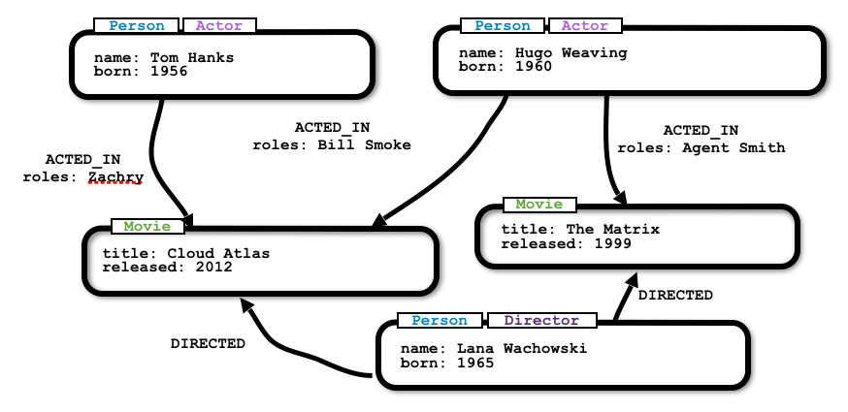
Matrix - add labels and properties

Slide 7
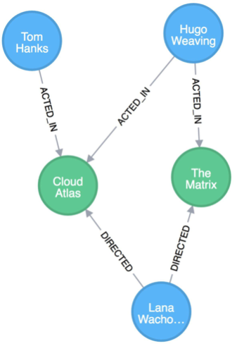
Matrix - final model in Neo4j

Slide 8
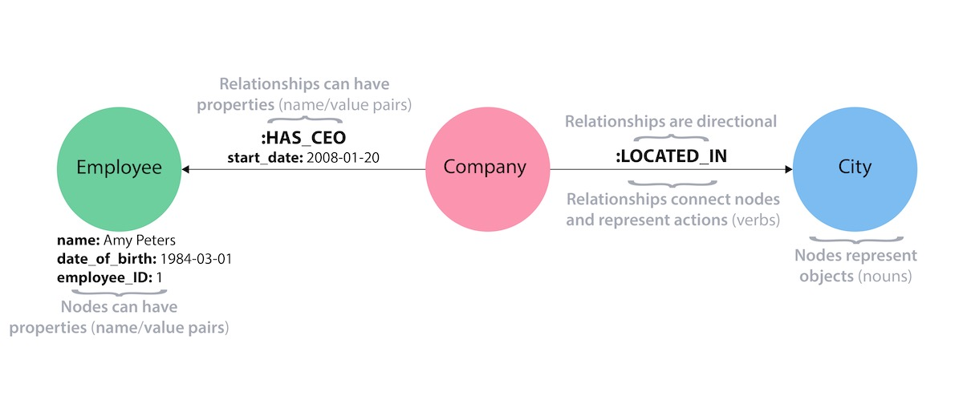
Review - Property Graph Elements

Slide 9
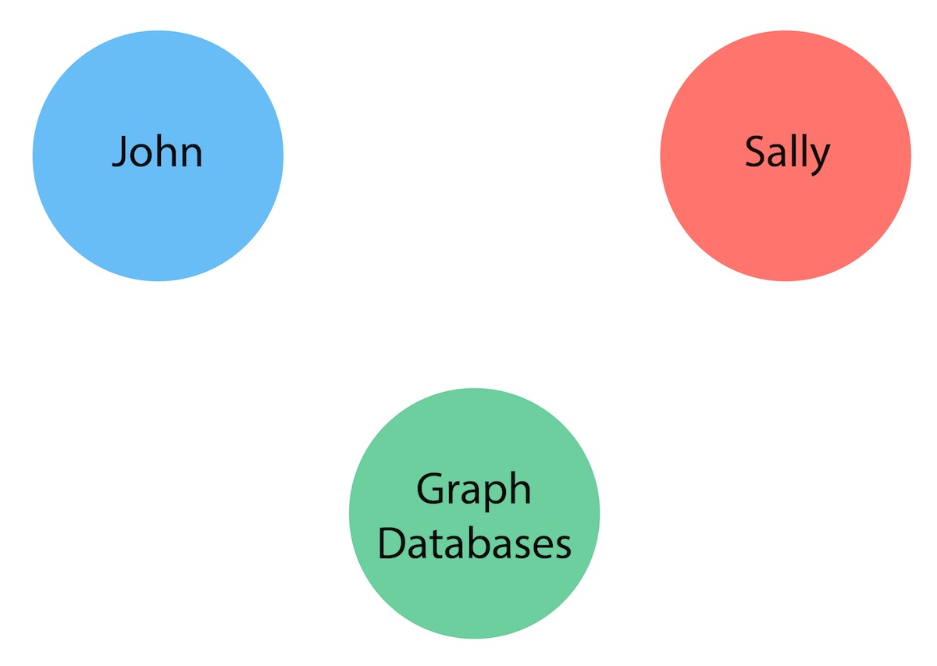
Graph Model - Nodes

Slide 10
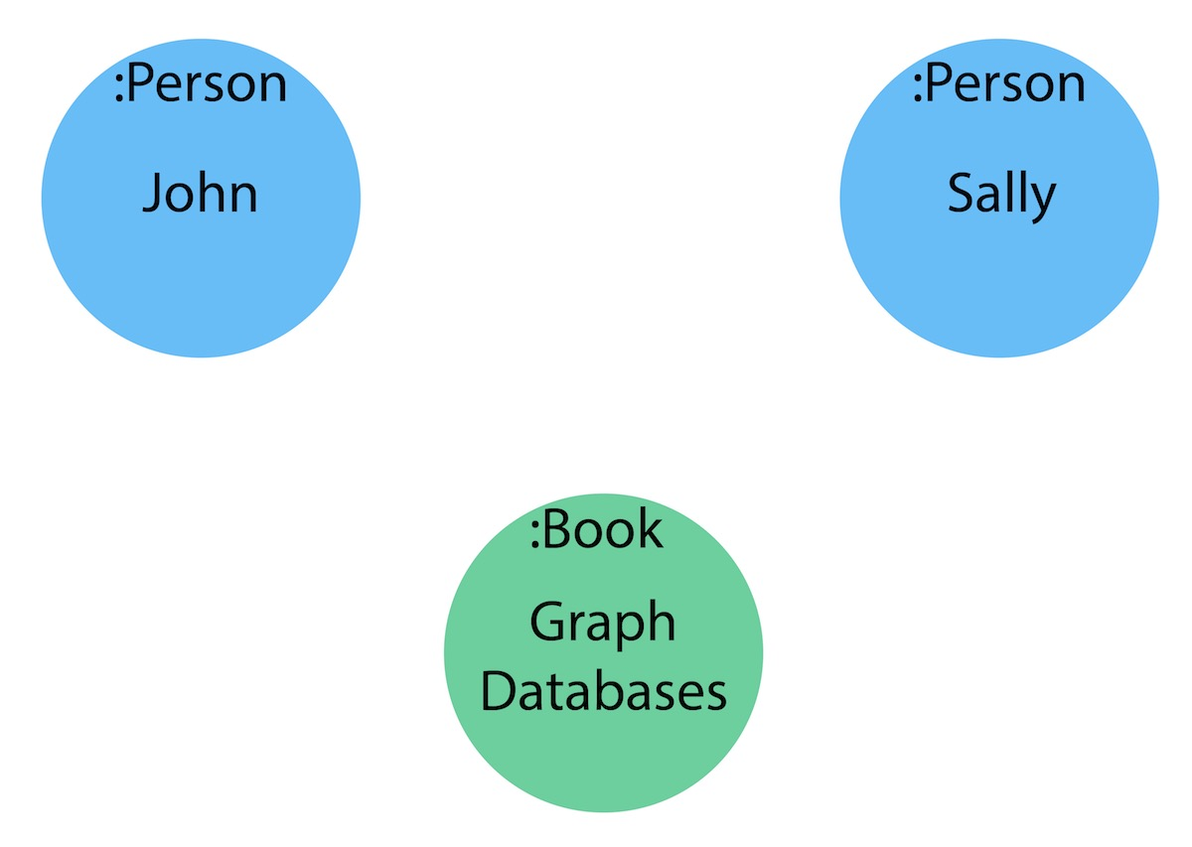
Graph Model - Labels

Slide 11
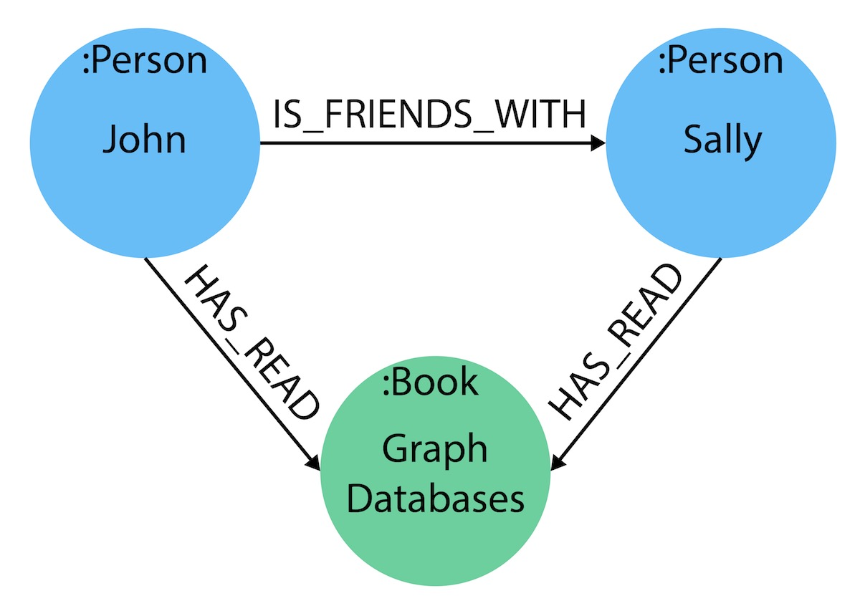
Graph Model - Relationships

Slide 12
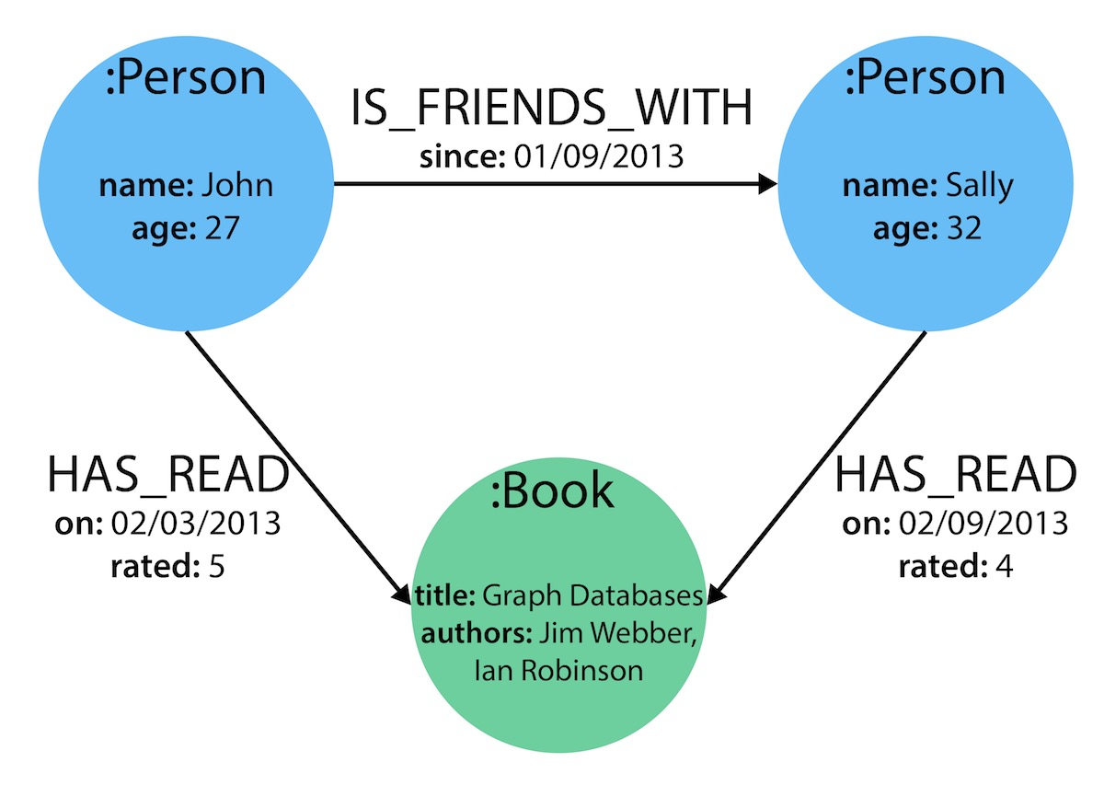
Graph Model - Properties

Slide 13
Modeling: From Relational to Graph

Slide 14
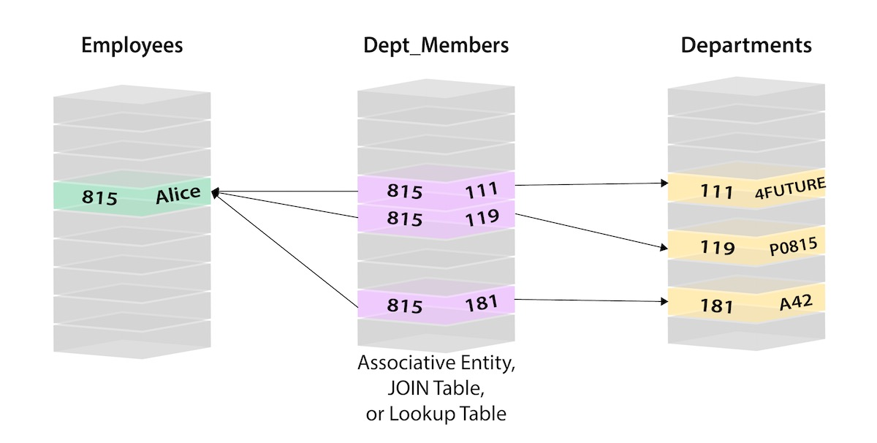

Slide 15
Data Model Transformation Tips
Table to Node Label - each entity table in the relational model becomes a label on nodes in the graph model.
Row to Node - each row in a relational entity table becomes a node in the graph.
Column to Node Property - columns (fields) on the relational tables become node properties in the graph.
Business primary keys only - remove technical primary keys, keep business primary keys.
Add Constraints/Indexes - add unique constraints for business primary keys, add indexes for frequent lookup attributes.
Foreign keys to Relationships - replace foreign keys to the other table with relationships, remove them afterwards.
No defaults - remove data with default values, no need to store those.
Clean up data - duplicate data in denormalized tables might have to be pulled out into separate nodes to get a cleaner model.
Index Columns to Array - indexed column names (like email1, email2, email3) might indicate an array property.
Join tables to Relationships - join tables are transformed into relationships, columns on those tables become relationship properties

Slide 16
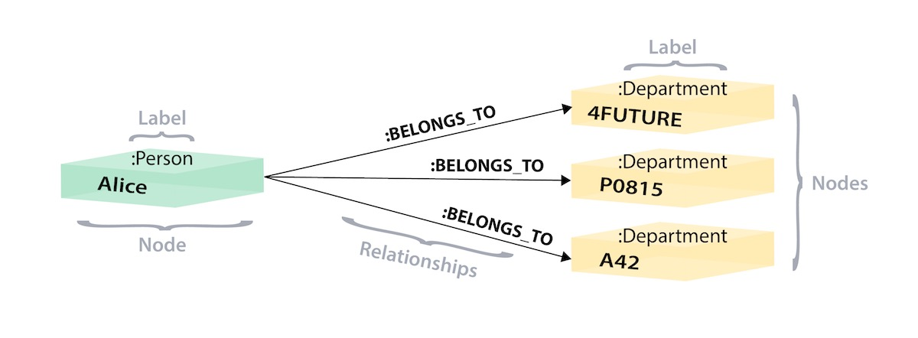
Data Model Transformation Tips

Slide 17
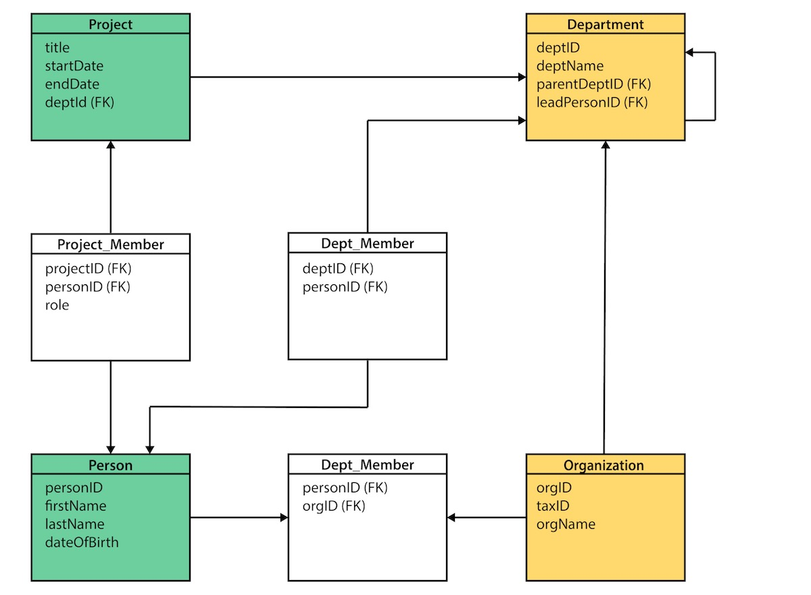

Slide 18
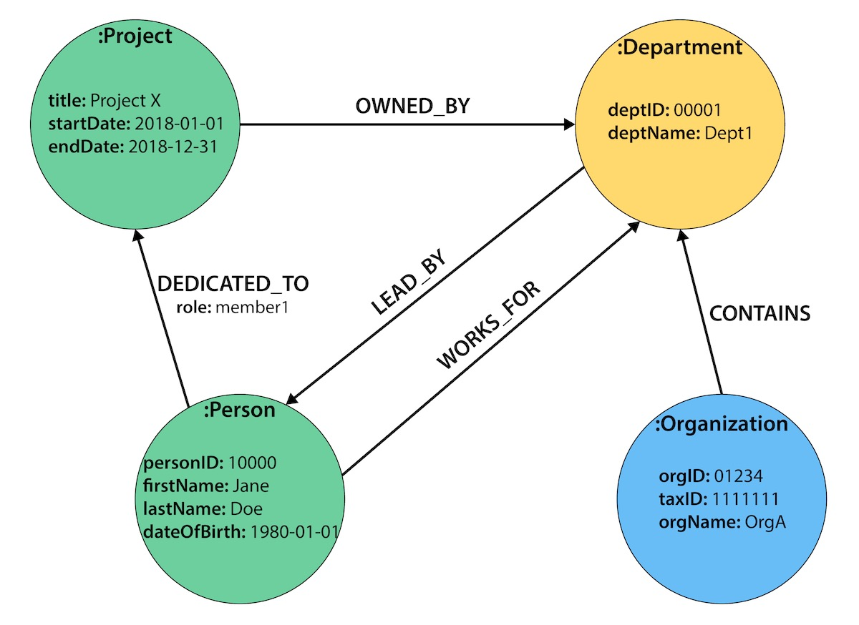

Slide 19
Conversion Steps
Categorize tables by main domain tables and associative entity tables by colors.
Turn our table names into node labels.
Project, Person, Department, and Organization become labels in graph model.
Rows on our tables become their own nodes and the columns in those rows become the properties on those nodes.
Row on the Person table will become a node with your name and date of birth as the properties on your node.
Any indexed columns that allow multiple similar values will become an array (such as skill1, skill2, skill3 columns translate to three values stored in an array property on a node).

Slide 20
Conversion Steps
If there are any technical primary keys (in other words, primary keys that were created simply to make the row unique - like a project_id in case there are multiple projects with the same title), then remove those and only keep the properties that are needed for the business requirements.
Will also need to add unique constraints for the business primary keys in order to ensure the database will not allow duplicates.
Foreign keys that would aid in relational join lookups are transformed into relationships, as they show the links between the nodes.
Join tables (or associative entity tables) become relationships, as well, with any join table columns moved to relationship properties.
Only store the needed properties in Neo4j, do not need to store nulls and empty values, so you can remove any default values that may have been created in a relational model.
Finally, any duplicate data created to normalize tables or de-normalize for simplicity’s sake needs removed, as it is unneeded in a graph.

Slide 21
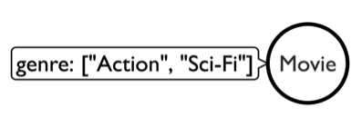
Property vs Relationship
Whether to model something as a property on a node or as a relationship to a separate node???
Take, for example, the data below modeling a movie genre as a property on the Movie node.

Slide 22
Property vs Relationship
To write a query finding the genre(s) of a particular movie is very simple.
It would find the Movie node it wants to know about, then return the values listed in the genre property.
However, to find out which movies share genres, you would need a much more complex query to find each Movie node, loop through each of the genres in the property array, and compare with each value in the second movie’s property array of genres.
This would take a toll on performance (nested looping and comparison of node properties), and the query would be much more complicated, as well
//find the genres for a particular movie
MATCH (m:Movie {title:"The Matrix"}) RETURN m.genre;
//find which movies share genres
MATCH (m1:Movie), (m2:Movie) WHERE any(x IN m1.genre WHERE x IN m2.genre) AND m1 <> m2 RETURN m1, m2;

Slide 23
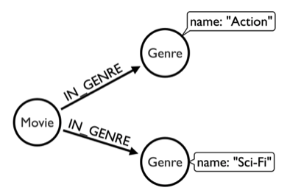
Property vs Relationship
Instead, if we were to model our movies and genres as separate nodes and create a relationship between the two, we would come up with a model something like the image below

Slide 24
Property vs Relationship
This creates a completely separate entity (node) for the genre, allowing you to connect all the movies with a shared genre to that Genre node.
To find the genres of a particular movie, it first needs to find the Movie node it is looking for (in this case, 'The Matrix'), then find the node that is connected to that movie through the IN_GENRE relationship.
Biggest difference is in the syntax for the second query to find which movies share genres.
Much simpler than our earlier version because it uses a natural, graph pattern (entity-relationship-entity) to find the information needed.
First, Cypher finds a movie and the genre it is related to, then looks for a second movie that is in that same genre.

Slide 25
Property vs Relationship
//find the genres for a particular movie
MATCH (m:Movie {title:"The Matrix"}), (m)-[:IN_GENRE]->(g:Genre) RETURN g.name;
//find which movies share genres
MATCH (m1:Movie)-[:IN_GENRE]->(g:Genre), (m2:Movie)-[:IN_GENRE]->(g) RETURN m1, m2, g

Slide 26
Graph Modeling
No right or wrong way to model your data.
Some ways may be better-suited to your needs and more performant on the aspects you prioritize, but you have options.
To find the best data model for your needs, it often helps to approach with a few techniques and make data model decisions from that analysis.

Slide 27
Write Your Queries First
Knowing the kinds of questions and queries you want to ask of your data is a great way to determining the structure of your data model.
If you know your queries need to return results within a certain date range, then you probably should ensure that date is not a property on a node, but rather stored as a separate node or relationship.
Even if you do not know the exact query syntax just yet, understanding the intention of the system or application you are building and then constructing the model around the business need will help you organize it in a more accurate way.

Slide 28
Prioritize Queries
Very difficult (if not impossible) to find the perfect model for every query or functionality.
There are tradeoffs with choosing one particular model over another (or using multiple).
While you may improve certain things, there is no way to get a one-size-fits-all solution.
Instead, you should determine which model best suits your needs.
You may not be able to max out performance on every individual query, but you may be able to get the most out of your system with certain resources, time, and code.
To do this, you will need to decide which queries must absolutely have maximum performance and which capabilities are critical to provide value.
May be a tough decision, but no matter the technology you are working with, these decisions will exist in some facet or other.
What makes Neo4j more valuable is that the model is flexible and able to change if your priorities adjust over time.

Slide 29
Test it Out
May come across scenarios that you did not realize in the design stages.
One of the best ways to find these is to actually test the model out.
Loading portions of your data and executing tests and queries on the system will determine if the results you receive fit your needs or your expected performance.
Again, Neo4j is flexible so that you can adjust the model or optimize your queries to fine-tune the outputs.
Try creating a proof-of-concept test for each model and both together and see how they operate.
What is complicated or what is not worth the hassle?
Is there one that actually performs better in real life or does a multiple-data-model approach truly give you the best results?
Sometimes, the best way to find out is to test it out with live data.

Slide 30
Refactoring your Graph
Changes are always possible with Neo4j.
Data model is purposely flexible and easy to adjust for this very reason.
Business needs and priorities tend to fluctuate.
Users may also change their behaviors and cause shifts for the business.
Cypher allows you to write queries to run mass updates across labels, add or remove properties, and insert additional nodes and relationships into the structure.
There are also procedures to aid in batching queries and executing updates to cluster instances, as available.

